Slide 1


Car-Nerd
DYNAMIC DEVELOPERS
PHASE 4

Slide 2

Development
Dynamic Developers is a small application development team working on desktop application termed Car-Nerd.
This application seeks to help facilitate the management of maintenance schedules and important vehicle information for their personal vehicles.
Idea Origin:
The team realized how time consuming and stressful tracking and maintaining a vehicle’s information for the average consumer can be.
For car enthusiasts, a dynamic app does not currently exist to suit their needs.
As a result, it became apparent to Dynamic Developers the need for an application that will provide users with a seamless way to record and track this important information.

Slide 3
Development
The Problem:
Vehicles owners have had to manually keep notebooks filled with documents and service records as a way to manage details and history regarding their vehicles.
The Solution:
Provided vehicle owners with a seamless and stress free way to manage vehicle history and details through an application that offers easy access will provide vehicle owners with the freedom of being able to track and record vehicle history and service details.
Features:
Mileage tracking
Oil change tracking
Store and display vehicle information (make, model, year, VIN and license plate numbers)
Add, store, and display notes regarding service details (when repairs/services are needed)
Notes:
Next I’m going to turn it over to Stephen who will give more details about Car-Nerd and share a little bit about our Client Operations and Executive Summary.

Slide 4
Development
Phase One: Research and Strategize
Discussed application requirements, business expenses
Developed project proposal and SOW
Selected coding platform
Decided which features will be included with each tier
Phase Two: Application Feature Development
Coded requirements, tested, debugged
Revisited features to determine if still valuable to overall application
Discussed roadblocks
Phase Three: Implementation
Deployed new desktop application
Phase Four: Management and Support
Project completed on July 24th, 2020.
Plan to provide web support
Will review issues and debug, push updates to application as necessary

Slide 5
Project Goals
Ability to add a vehicle to the application and give the vehicle a personalized name
Ability to add year, make, and model to vehicle profile
Ability to schedule service reminders
Track oil changes
Track mileage
Track details for multiple vehicles in one central location
Ability to charge a user a monthly or yearly subscription fee for the application service ($3.99/mo or $39.99/yr)
Be user friendly

Slide 6
Development
System Overview:
Car-Nerd was designed to be supportive and effective for users and provide a foundation for future growth. The application is user friendly so that users which are not as tech savvy will not have any issues when using the application. The user interface is clear and concise which adds to the overall user experience. The application is compatible with most operating systems and allow for users to name their vehicles to assist with vehicle tracking and to provide a more personal experience.

Slide 7
SYSTEM DESIGN
Add Car module - allows user to add vehicle details (optional name, make, model, year, trim)
Mileage module - allows user to enter and update mileage. Also tracks oil change mileage.
Notes module - designed to allow user to enter comments related to the selected vehicle. Ex: “Need to purchase new battery for key fob” or “Car making funny noise, need to call dealership”.
Other design components:
mileage displays on main screen
View Note button lets user select/review specific notes
Delete Car allows user to remove vehicles no longer needed.

Slide 8
System Architecture
Hardware:
Team members worked remotely, and hardware components and setup ranged between the group, however, all developer setups successfully and effectively worked on system design, including UI work and the coding of the application.
Developer Computers consisted of: - 8GHz Server Suite - RAM: 8 GB - 6x 80GB 15,000 RPM Hard Drive - 6x Power Cord + Charger - 1 TB SAN Storage Device - 6x Dell P3000 Workstations - 6x Viable Wifi Routers

Slide 9
System Architecture
Software:
Dynamic Developers’ application works with various components to store and display user data. The software creates a database in which input can be entered and modified by users to make information easily accessible by the user. The components are:
Ability to add a vehicle to the app and/or select a previously added vehicle.
Users can specify a name, the make, model, trim, and year for the vehicle they have added.
Store reminders and give ability to log maintenance service data.
Time tracking
Notes
Displays events added to log
Hold and calculate the mileage of the user's vehicle.
Mileage at last oil change
Current mileage
Date of last oil change

Slide 10
Database
Car-Nerd utilizes a database from a public online source - Kelley Blue Book, which holds all year, make, and model available in the US. This allows the user to quickly select their car with the three drop down options.
With the database being analyzed within the code, it also ensures that they cannot accidently select a car make and model that do not match.

Slide 11
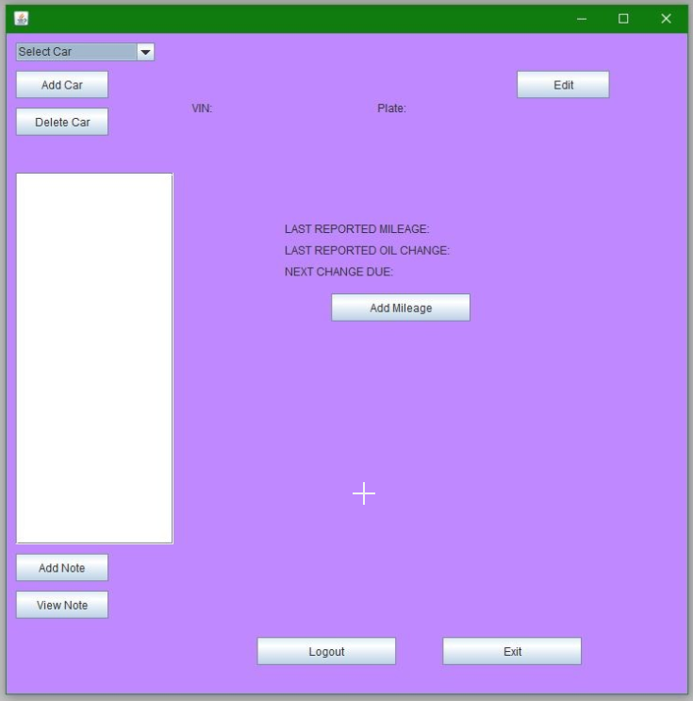
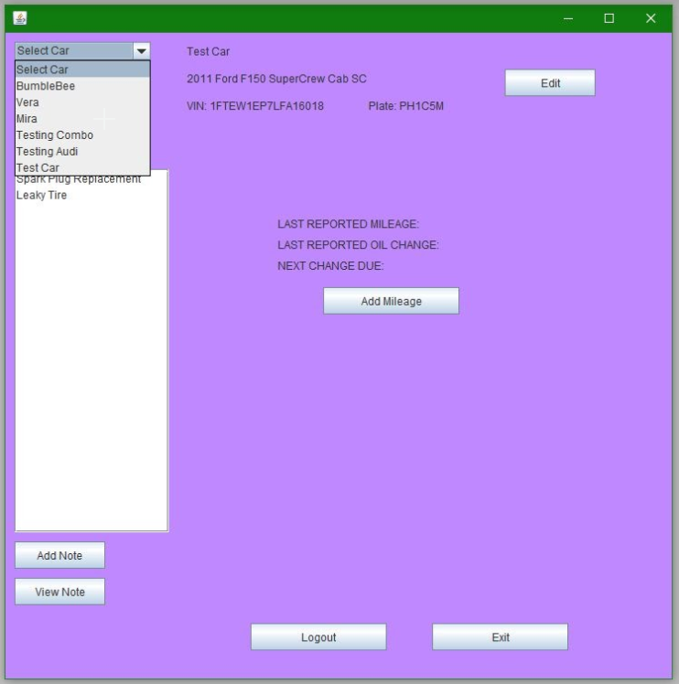
User Interface - Main Display
This is the Main screen that users see when opening the Car-Nerd application.
This is the Main screen display once a user has selected a vehicle from the database. The details for that vehicle are displayed at the top of the screen.

Slide 12
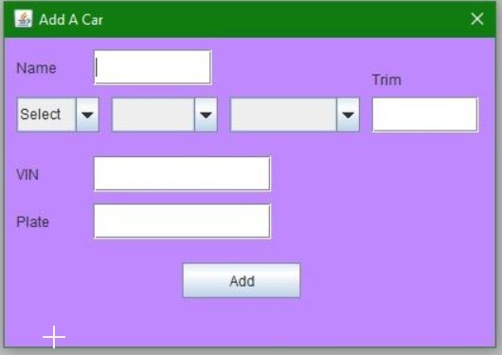
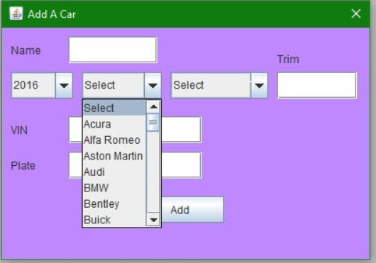
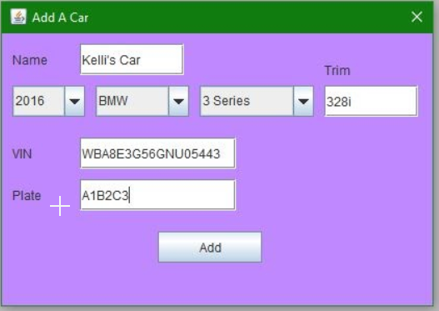
User Interface - Add Car Display
Add Car popup screen with car being selected.
Add Car screen with car added.
Add Car popup screen

Slide 13
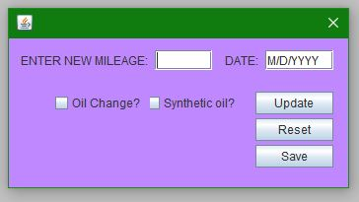
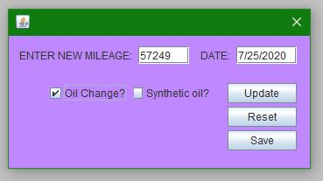
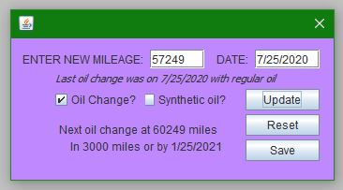
User Interface - Mileage
Add Mileage main screen
Add Mileage main screen with mileage added and Oil Change checked.
Add Mileage main screen with Oil Change information updated.

Slide 14
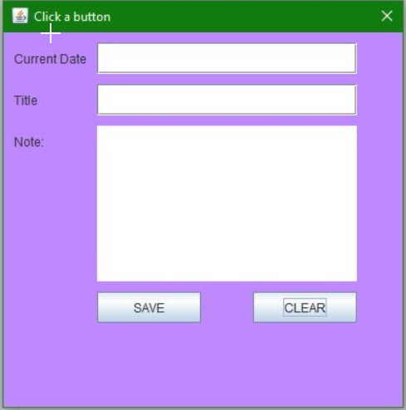
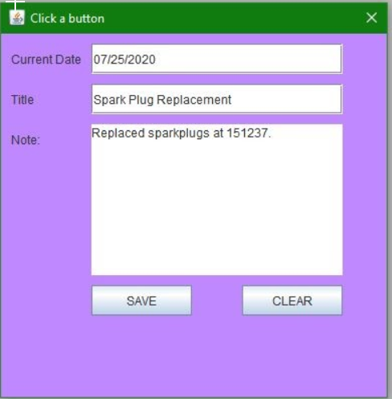
User Interface - Notes Display
This is the screen that users will see when they press the Add Note button.
This is the screen displayed with note information for the selected vehicle.

Slide 15
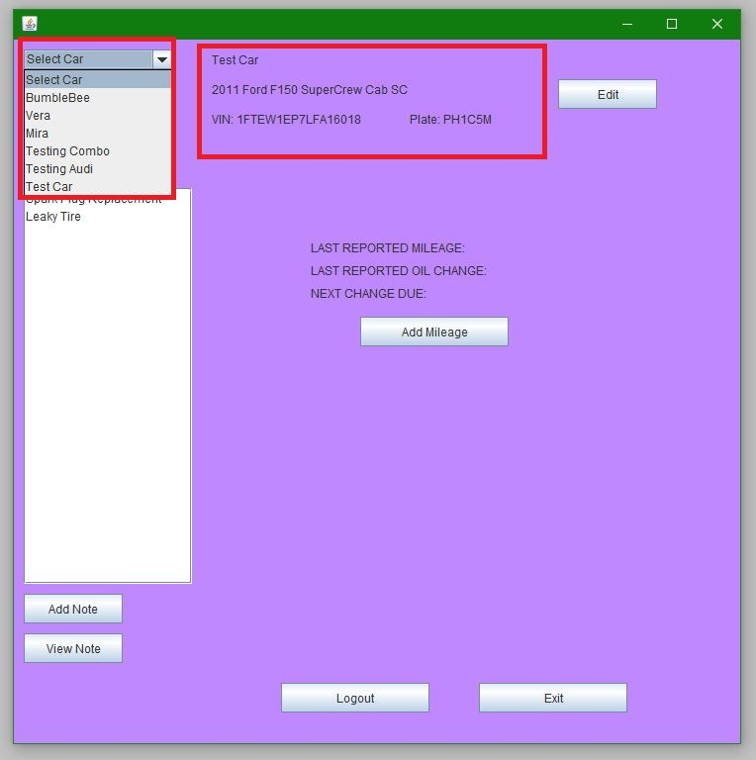
Output
Adding a car will allow users to input their car details into the program.
From there the car details will be represented on the main page.
The car title will also be shown in the “select car” drop-down menu from which the user can select from their cars.
Selecting a different car will give access to the mileage and notes of that car as well as display the selected car details on the main page.

Slide 16
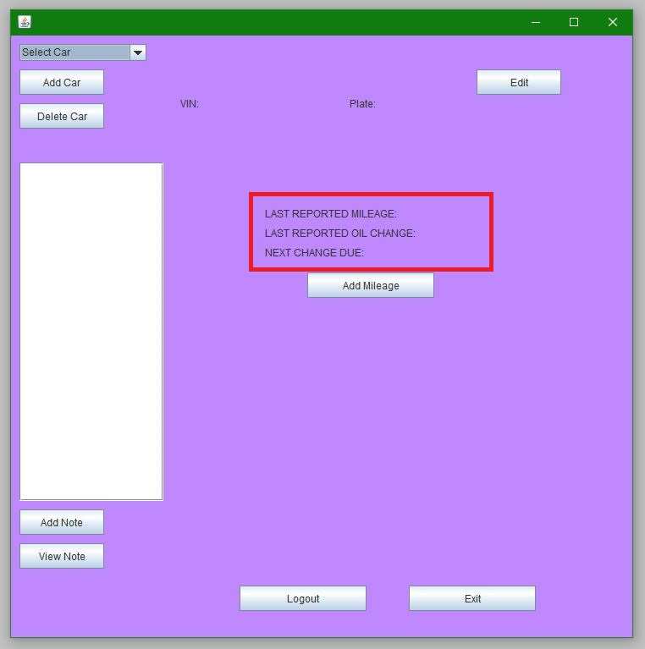
Output
A user can input there mileage to a selected car with a date and type of oil change if any. The mileage last reported, last report oil change, and next oil change due will all be shown on the main screen. “Next change due” displays the next oil change date using the formula. The tracker will notify the user if they are over the limit. Conventional Oil Formula: Last oil change mileage + 3000 miles Last oil change date + 6 months
Synthetic Oil Formula: Last oil change mileage + 5000 miles Last oil change date + 9 months

Slide 17
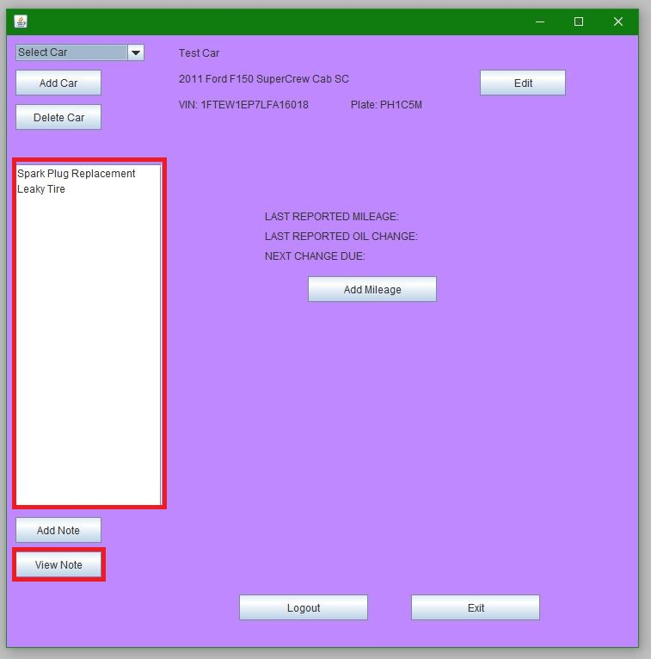
Output
A user can input a title, date, and description to notes of a selected car. The title of the note will be displayed on the main page and can be selected. “View notes” will display the note selected to see it’s date and description.

Slide 18
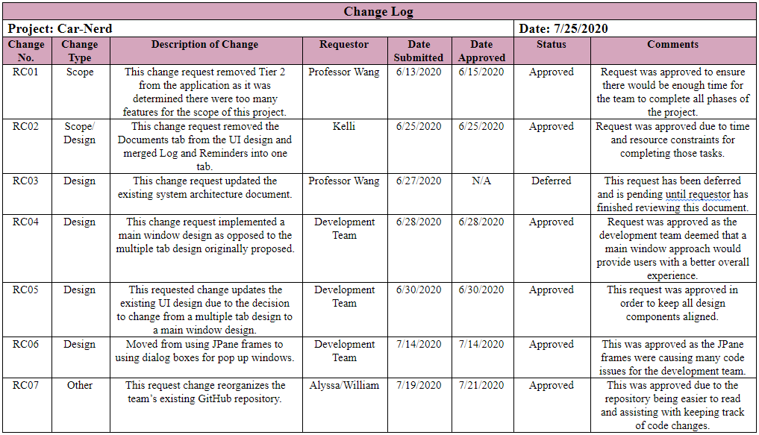
Change Log

Slide 19
Lessons Learned
Throughout our time with this project, we have learned many lessons of software development. Such as:
Learning to manage our project scope overall.
Managing to set up a new team member after the project has begun.
Managing workload for certain members to not be so high compared to others.
Also learning how to setup and commit to github to easily merge together each others’ code.
Finally, we also learned that the system architecture chart is something essential to the wellbeing of the project, and how to create one that is excellent for our case.

Slide 20
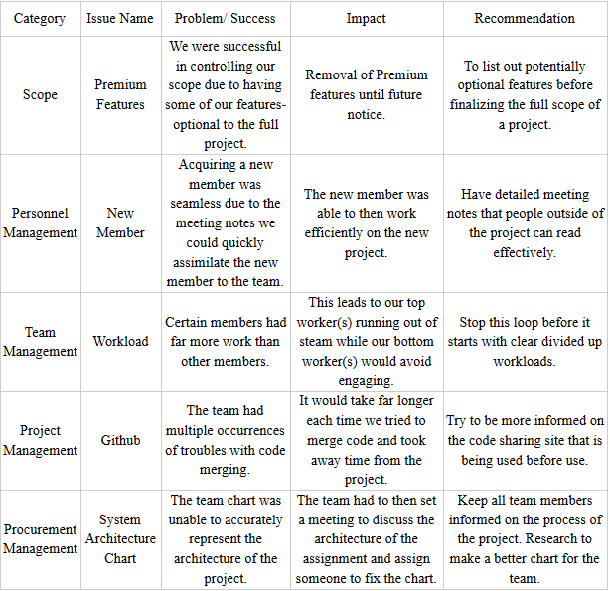
Lessons Learned

Slide 21

Questions

